Slide 1

Analyzing NYC 311 Data
Hansol Kim
EAI 6120
December 18, 2021

Slide 2

Data Sources
NYC open Data : 311 Service Request from 2010 to Present
Data includes 7.6 Million Requests (Jan 2019 - mid Dec 2021)

Slide 3
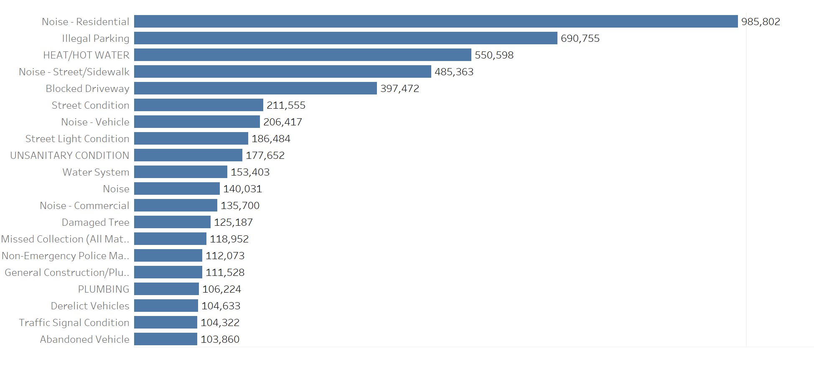
Top 20 Complaint Type
Complaints are mostly related to noise, vehicle, traffic and utilities
Noise complaints are the major category

Slide 4
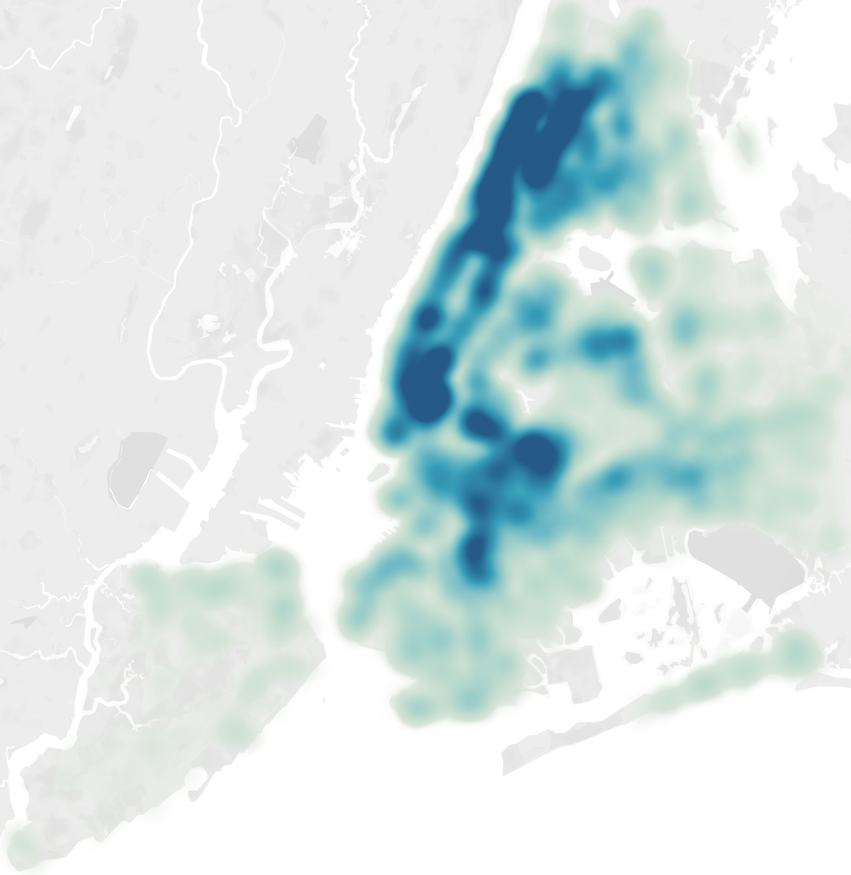
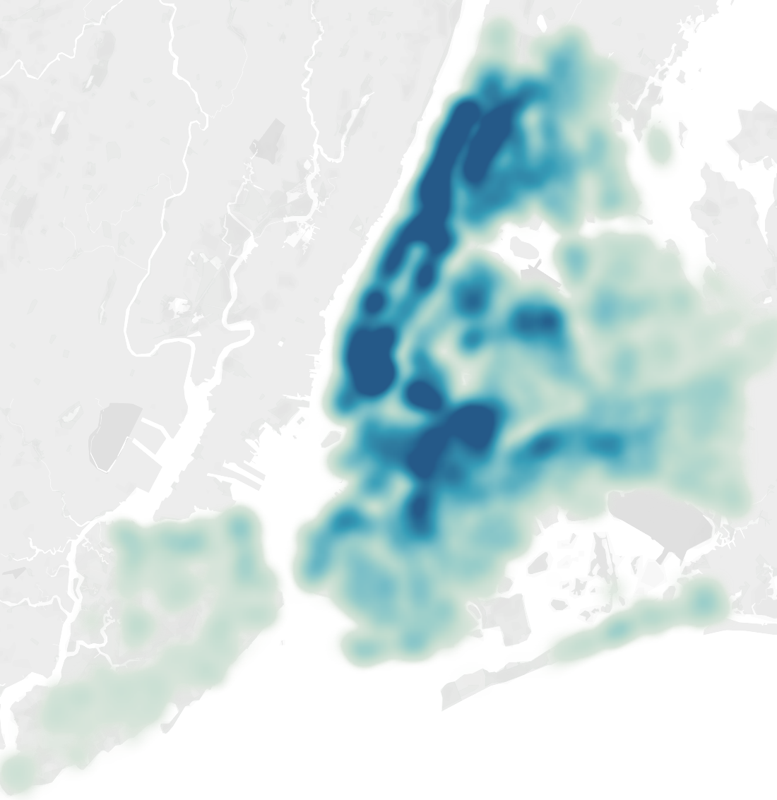
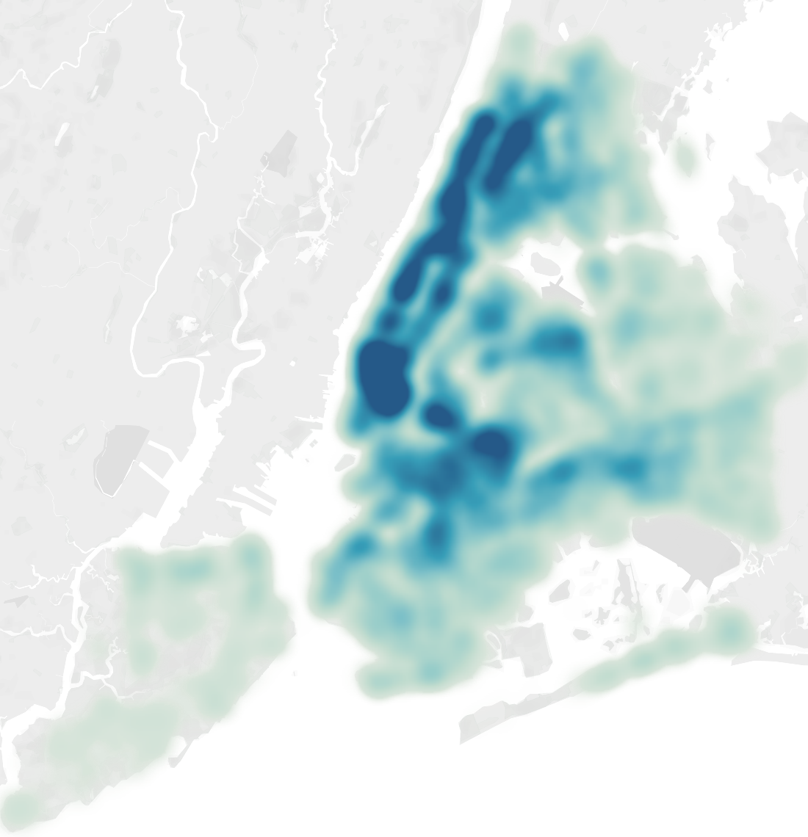
Top 20 Complain Distribution by Borough Over Time
2019
2020
2021

Slide 5
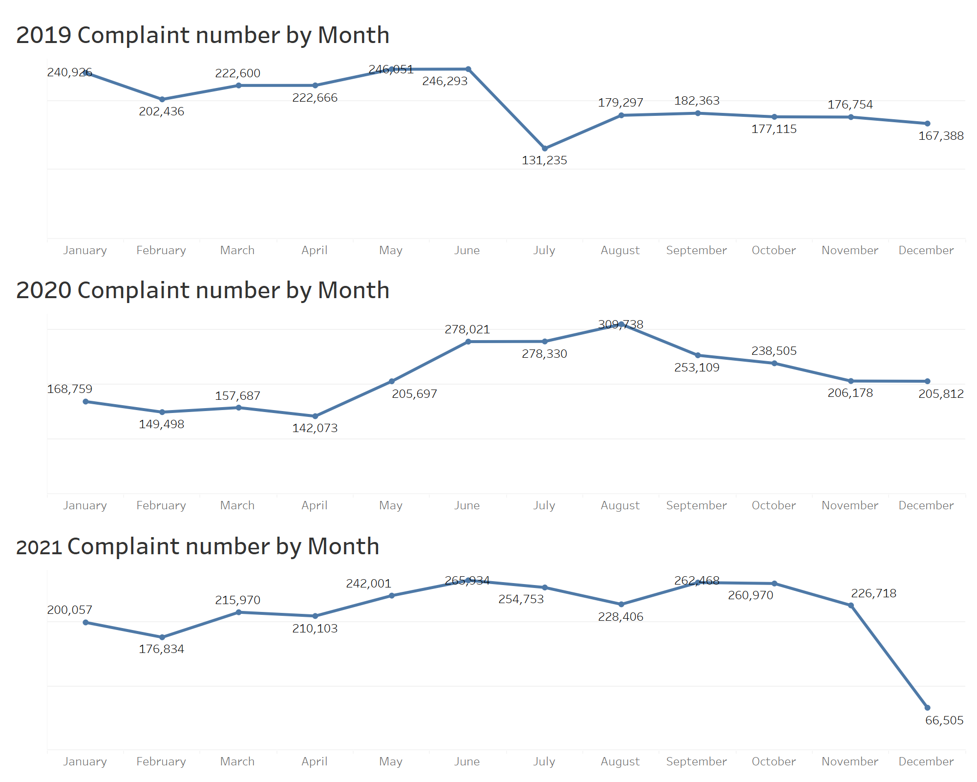
Covid-19 / Shutdown impact on 311 Request
Shutdown impacted on the number of request cases during certain period
Covid - 19 impacted on request trends (Historically request decrease in June - July)
Due to Covid - 19, complain request increased

Slide 6
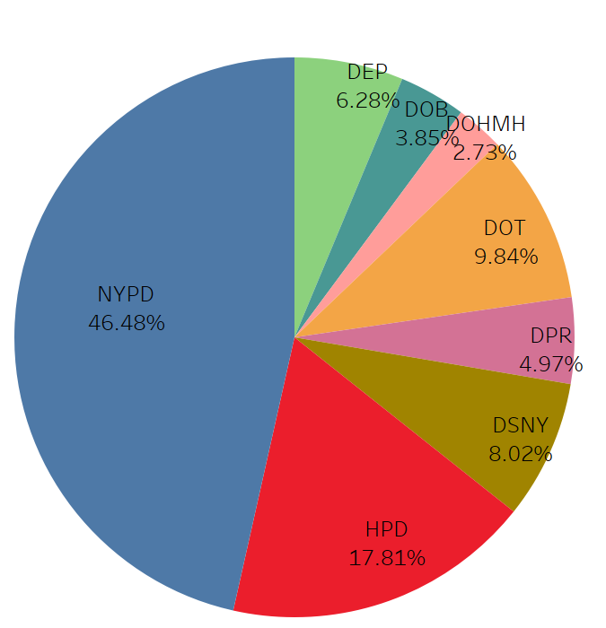
Complaint counts with Top 8 Department
14 out of 28 departments receives most of complaints
NYPD takes the largest share of request
Some departments barely receive complaint

Slide 7
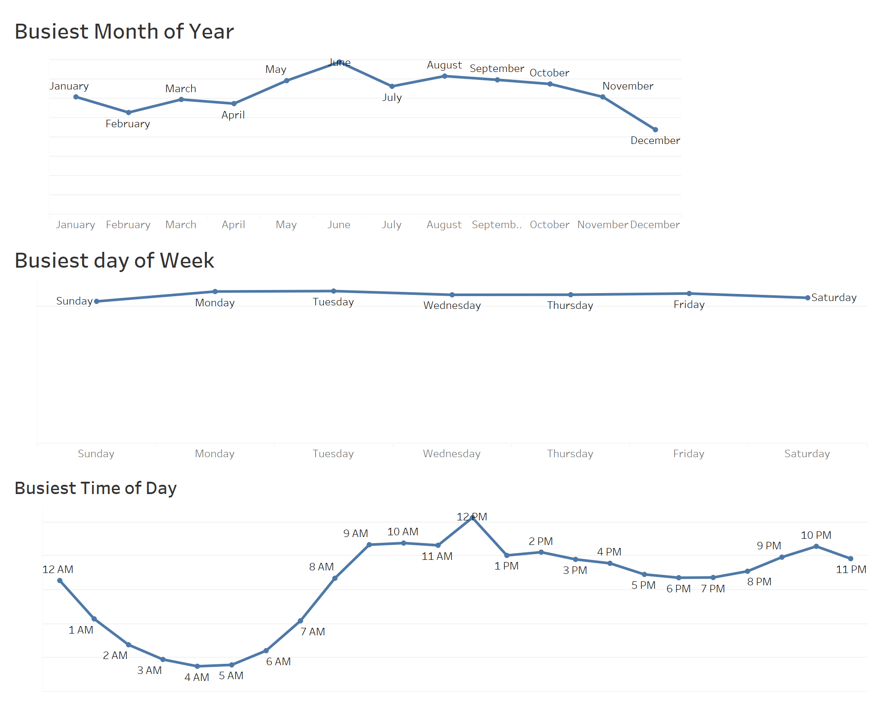
When is the Busiest?
Spring to Fall is the busiest season of the year
Regardless of the day, people request service
Request starts to Increase at 04:00, Peak at 12:00 and Start to Decrease Midnight

Slide 8
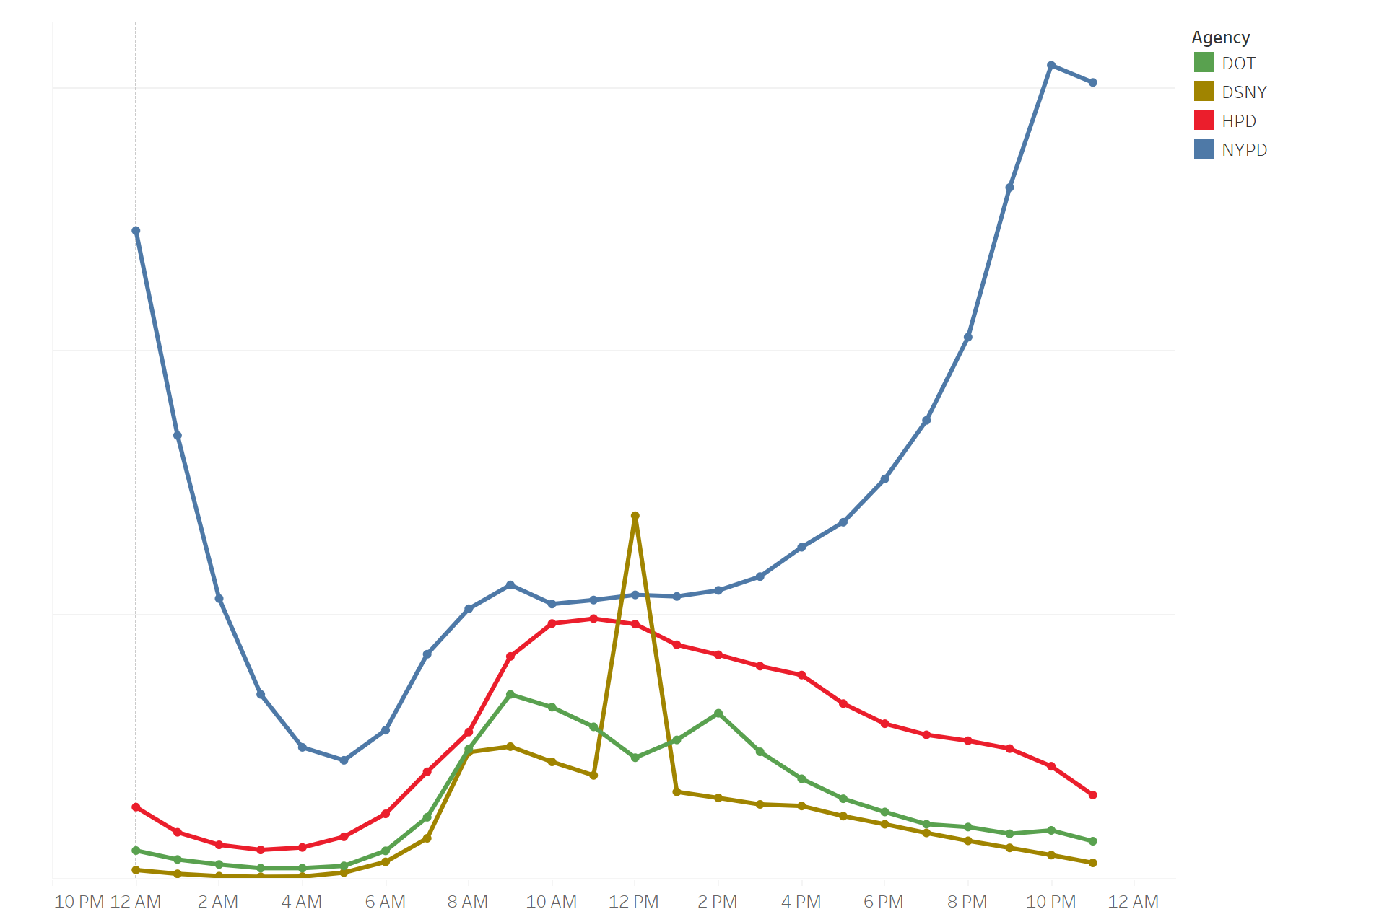
Top 4 Departments Total Calls by Hour
Most calls to the departments are made during the day
Most calls to the NYPD are made evening to early morning (8 P.M to 4 A.M)
HPD is the busiest in the day, NYPD is the busiest in the evening to early morning

Slide 9
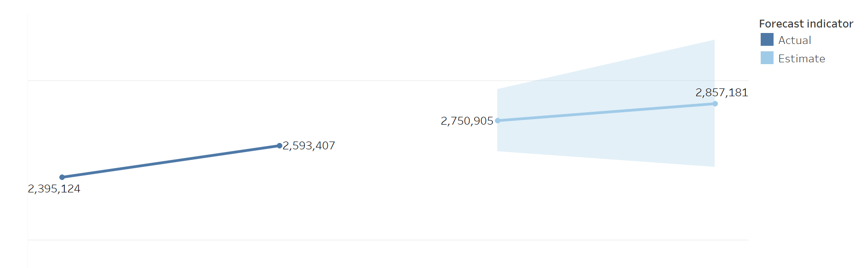

Predict - Total Count of Complain Over Years
The number of Complain is constantly increasing over years
As Pandemic hasn’t over yet, the complaint will keep increase

Slide 10
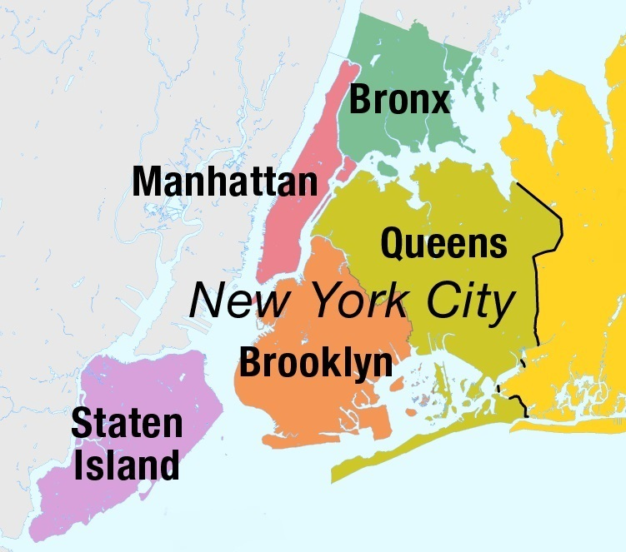
Recommendation
Distribute Labor can elevate efficiency
14 out of 28 departments handle most of the complain
Department other than NYPD should handle larger share
Agencies other than NYPD also should handle request at night
Arrange for Peaks in Call Volume
May to October is the busiest season of the year
Extreme weather events can cause peaks in this season
Lacks of department handle request can cause peaks in evening to early morning

Slide 11
Thank You

